Slide 1


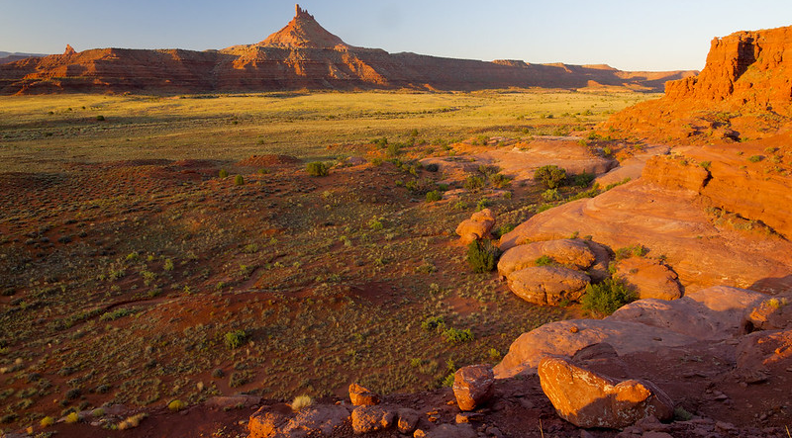
Public Meeting
U.S. Department of Agriculture
Forest Service
Bears Ears National Monument

Slide 2



Bears Ears Commission
U.S. Department of the Interior
Bureau of Land Management
U.S. Department of Agriculture
Forest Service
The Bears Ears Commission, established by proclamation 9558, consists of an elected officer from each of the 5 Tribal Nations.
The Federal Agencies collaborating with the BEC in planning and management of BENM.
Commission members include:
Name | Tribal Nation
Vice Chairman Christopher Tabbee (Co-Chair) | Ute Indian Tribe
Vice Chairman Craig Andrews (Co-Chair) | Hopi Tribe
Councilman Malcolm Lehi | Ute Mountain Ute Tribe
Head Councilman Anthony Sanchez | Pueblo of Zuni
Council Delegate Curtis Yanito | Navajo Nation

Slide 3
Participants in the Process
U.S. Department of the Interior
Bureau of Land Management
U.S. Department of Agriculture
Forest Service
  Bears Ears Commission
  Ute Mountain Ute
  Hopi
  Navajo
  Zuni
  Ute Indian Tribe
Elected Officials
  Senator Mike Lee
  Senator Mitt Romney
  Representative John Curtis (R-UT-3)
  Representative Blake Moore (R-UT-1)
  Representative Burgess Owens (R-UT-4)
  Former Representative Chris Stewart (R-UT-2)
  Native American Tribal Nations
  32 Tribal Nations
  Federal Agencies
  National Park Service
  U.S. Fish and Wildlife Service
  Environmental Protection Agency
  National Historic Preservation Act
  Advisory Council on Historic Preservation
  Consulting Parties
  State of Utah
  Utah Public Lands Policy Coordinating Office
  Utah School and Institutional Trust Lands Administration
  Utah Division of Wildlife Resources
  Utah State Historic Preservation Office
  Utah Department of Natural Resources
Local Government
San Juan County
Grand County
City of Blanding
Town of Bluff
City of Monticello

Slide 4
Public Comment Period
U.S. Department of the Interior
Bureau of Land Management
U.S. Department of Agriculture
Forest Service
Opportunity for the public/community members to comment on the plan and how they would like to see BENM managed.
~90 days (March 8 – June 11)
How to submit a comment:
  Online
    ePlanning:
    https://eplanning.blm.gov/eplanning-ui/project/2020347/510
  Mail
      Bureau of Land Management
      Bears Ears National Monument
      P.O. Box 7, Monticello, Utah 84535
  Comment card or court reporter at an in-person public meeting

Slide 5
Substantive Comments
U.S. Department of the Interior
Bureau of Land Management
U.S. Department of Agriculture
Forest Service
Best public comments:
  Raise questions about accuracy of information or methodology
  Present new, relevant information for the analysis
  Present reasonable alternatives to what is currently presented
Comments are not used as votes for alternatives
Comments that only express an opinion or preference will be considered, but will not receive a formal response from the agencies

Slide 6
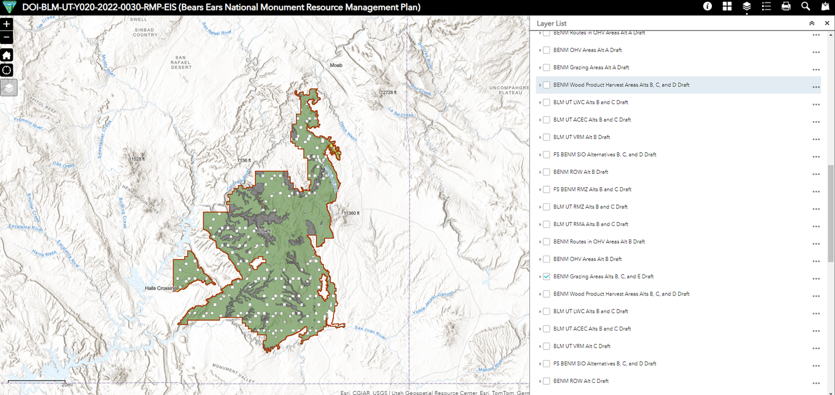
ePlanning
U.S. Department of the Interior
Bureau of Land Management
U.S. Department of Agriculture
Forest Service
https://eplanning.blm.gov/eplanning-ui/project/2020347/510
  Volume 1 and 2 PDFs available
  “Participate Now” button for comments
  Interactive map

Slide 7
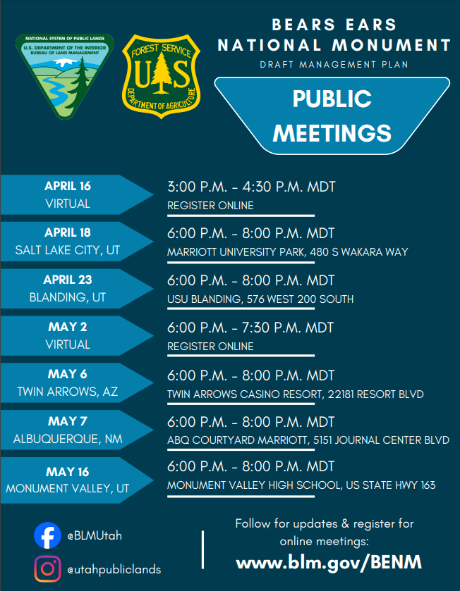
Draft Management Plan
MST

Slide 8
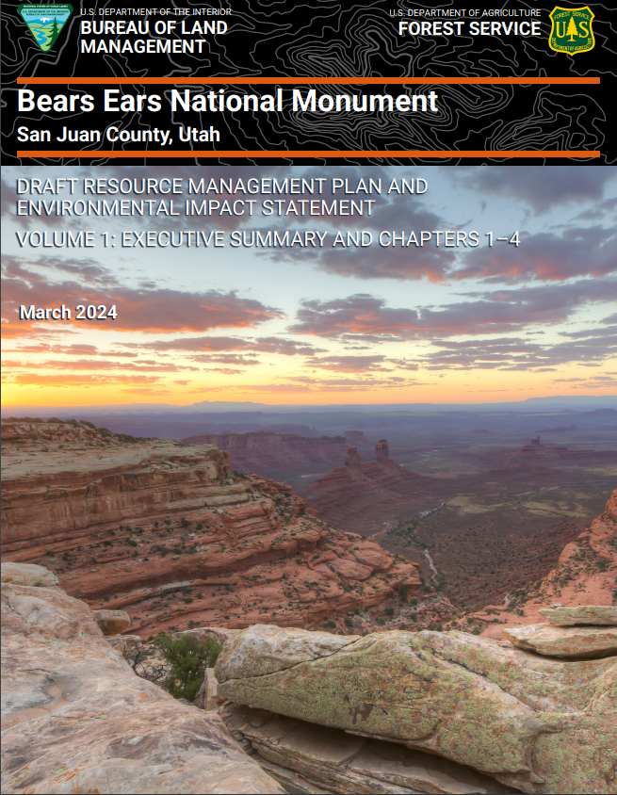
Draft Resource Management Plan and Next Steps
U.S. Department of the Interior
Bureau of Land Management
U.S. Department of Agriculture
Forest Service
Range of Alternatives
  A: Current Management
  B: Most permissive – focus on on-site development to provide education for protection
  C: Limited development with focus on off-site education for protection
  D: Focus on natural processes and limiting discretionary actions
  E: Emphasizes traditional indigenous knowledge with consideration of natural processes and seasonal cycles
Preferred Alternative
  Alternative E
  Does not constitute a commitment or decision
  Agencies can select a different alt. or a blend based on comments received
Draft Plan has a 90-day public comment period
  Comments from the public, State and local governments, Tribal Nations, Bears Ears Commission, and other federal agencies will be compiled and considered
Develop a Proposed Plan

Slide 9
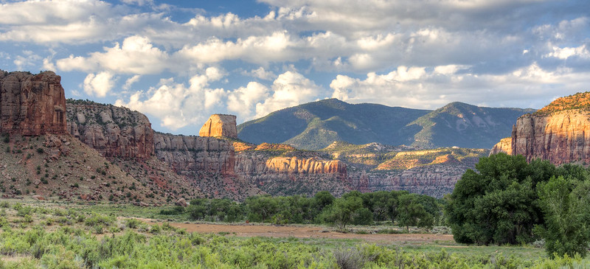
Resource Stations
U.S. Department of the Interior
Bureau of Land Management
U.S. Department of Agriculture
Forest Service
Livestock Grazing
Recreation
Lands and Realty
Cultural Resources
Q&A Station
Planning Process
Comment Station
Thank you for attending! Your time and participation are greatly appreciated.

